Slide 1
Electrical Resistivity Imaging with Subsurface Boundary Constraints
Jodi Mead*, Hank Hetrick**, John Bradford†
*Professor, Department of Mathematics, Boise State University
**PhD Candidate, Department of Geosciences, Boise State University
†Professor, Department of Geophysics, Colorado School of Mines

Slide 2
Outline
Electrical Resistivity Tomography (ERT)
Prior information and joint inversion
Assessing uncertain prior information
Results from Boise Hydrogeological Research Site (BHRS)

Slide 3
Boise Hydrogeological Research Site
Field laboratory on a gravel bar adjacent to the Boise River, 15 km southeast of downtown Boise.
Consists of coarse cobble and sand. Braided stream fluvial deposits overlie a clay layer at about 20 m depth.
Difference in retention properties in a lenticular sand feature yields significantly different geophysical properties.

Slide 4
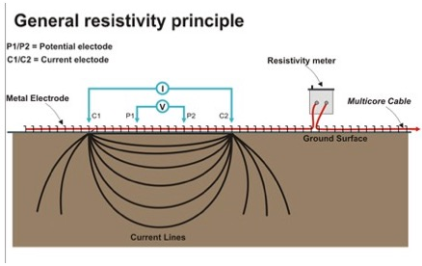
Electrical Resistivity Tomography (ERT)
2D grid of observations provides a 3-D inverted model that emphasizes the sand lenticular feature.
BHRS survey consisted of 12 electrodes spaced 1 meter apart acquired with a dipole-dipole configuration.
BHRS survey acquired at surface when subsurface achieved saturation.

Slide 5
Ohm’s Law
Model parameters – resistivity
Observed data – apparent resistivity
- electrical potential difference across receiver electrode pair
- contains geometrical information about electrodes
- locations of current source electrodes A and B

Slide 6






Constrained Inversion (Regularization)
$$φ[m]={ \left||W\left(F\left[m\right]−d\right)\right||}_{2}^{2}+α^{2}{|\left|Lm\right||}_{2}^{2}$$
$$m :model parameters (resistivity)$$
$$F\left[ \right] :forward model \left(Ohm^{′}s Law\right)$$
$$d :observed data (apparent resistivity)$$
$$α :regularization parameter$$
$$W=diag\left(1/σ\right),σ data error estimates$$
$$L= \frac{1}{Δx}\left[\begin{matrix}−1 1 & ⋯ & 0 \\ ⋮ & ⋱ & ⋮ \\ 0 & ⋯ & −1 1\end{matrix}\right]$$

Slide 7
Discontinuous Inversion: Relaxing the Constraint
$$φ[m]={\left||W\left(F\left[m\right]−d\right)\right||}_{2}^{2}+α^{2}{|\left|RLm\right||}_{2}^{2}$$

Slide 8
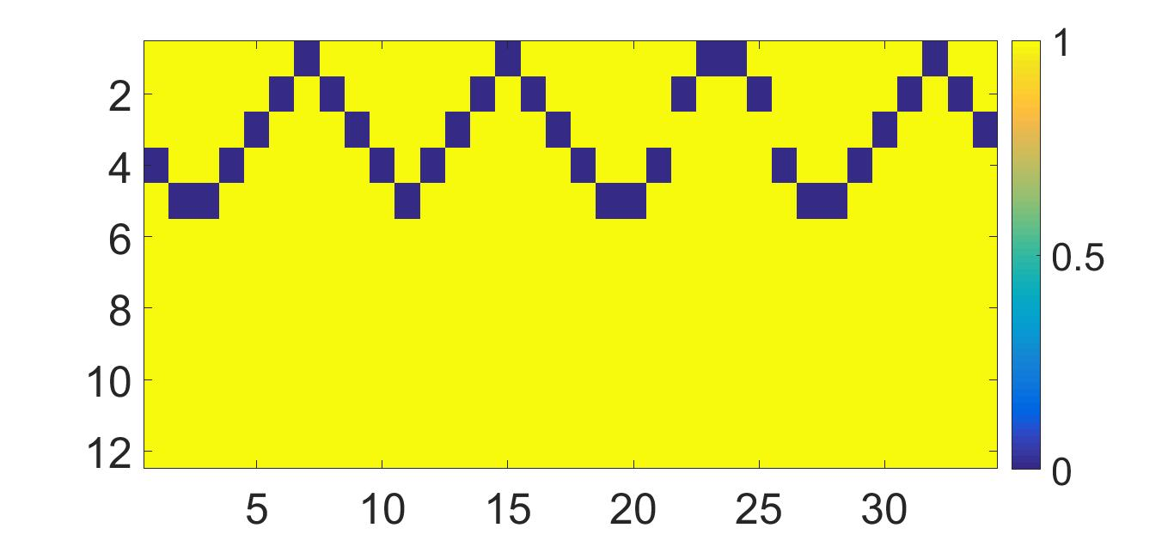
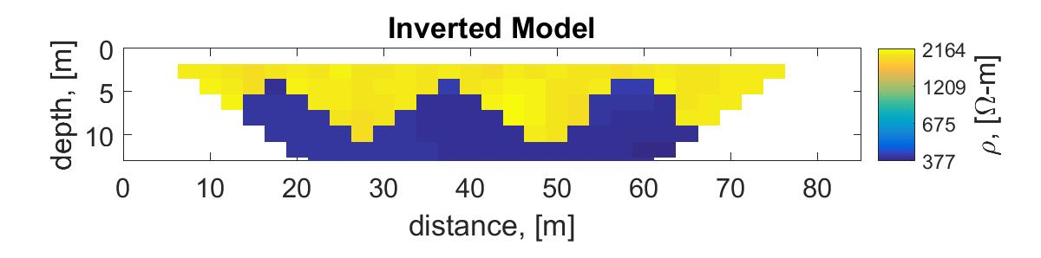

Joint Inversion: Incorporating Prior Information
$$diag\left(R\right)=$$

Slide 9
Ground Penetrating Radar (GPR)
GPR survey at BHRS acquired across center of gridded ERT survey.
GPR sampled line collinear with ERT survey.
GPR derived boundary gives prior boundary knowledge in the ERT dataset.

Slide 10
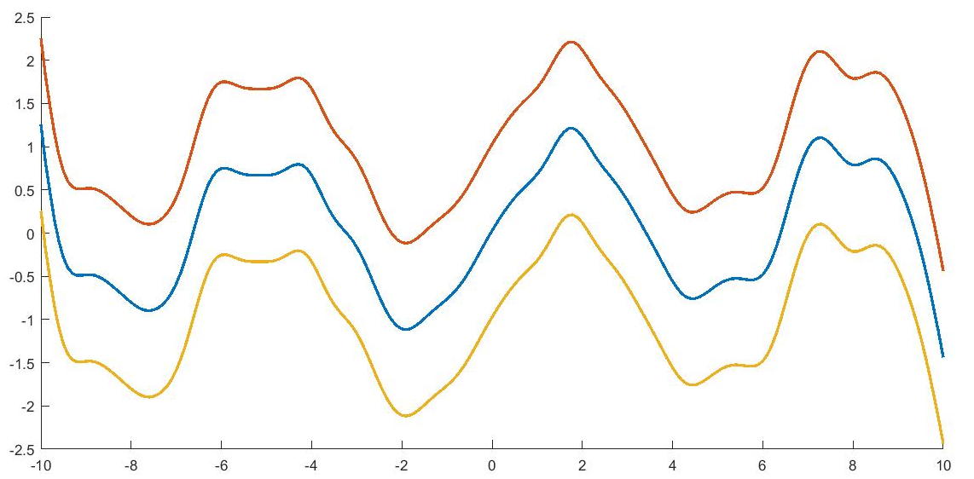
Uncertain Boundary Location
Given n_{s} subregions, which boundary estimate R is best?

Slide 11



Identify Best Boundary Estimate: Data residual
$${ φ}_{d}[\hat{m}]={ \left||W\left(F\left[\hat{m}\right]−d\right)\right||}_{2}^{2}$$
$$\hat{m}=argmin{ \left||W\left(F\left[m\right]−d\right)\right||}_{2}^{2}+α^{2}{|\left|RLm\right||}_{2}^{2}$$
As $α→∞$
Homogeneous $\hat{m}$, ${ φ}_{d}$ not minimized
Prior R gives n_{s} homogeneous subregions
Variability in $φ_{d}[\hat{m}\left(R\right)]$ due to boundary location
$\hat{R}$ = arg${{\min_{R} \{ lim}_{α→∞} φ}_{d}\left[\hat{m}\left(R\right)\right] \}$

Slide 12
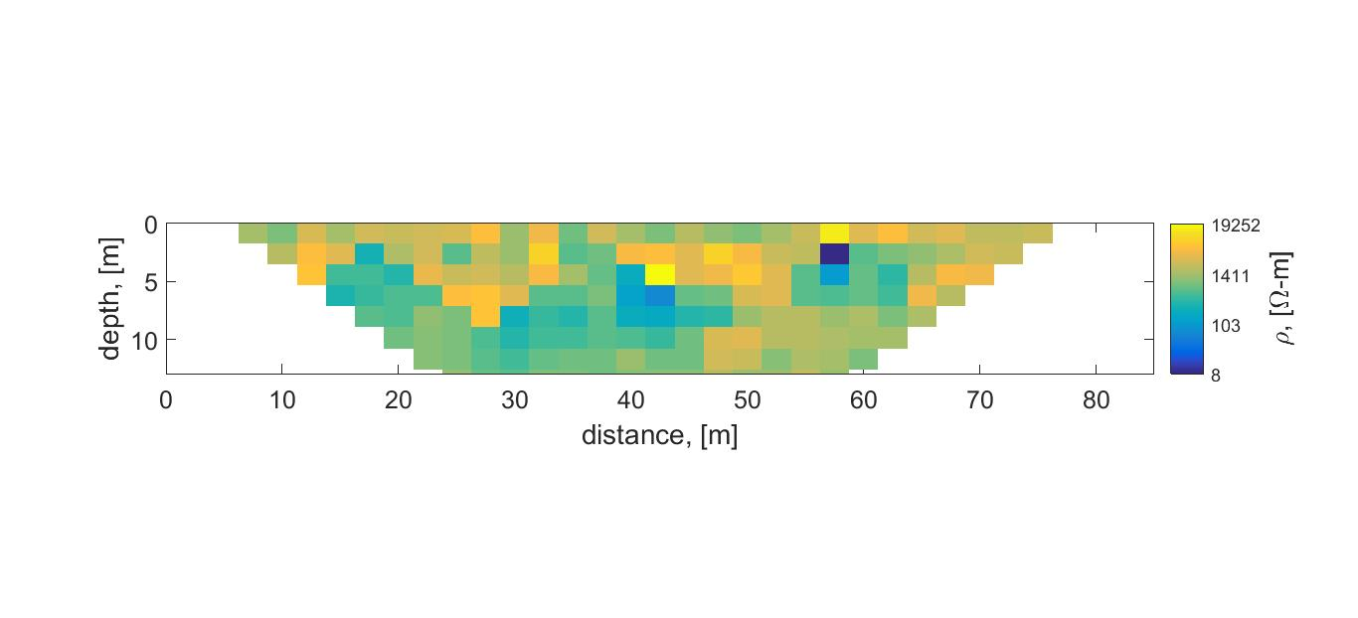
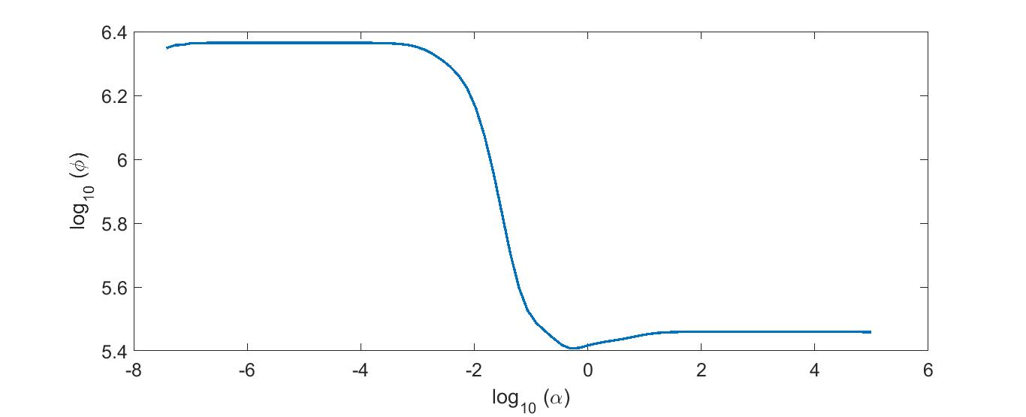
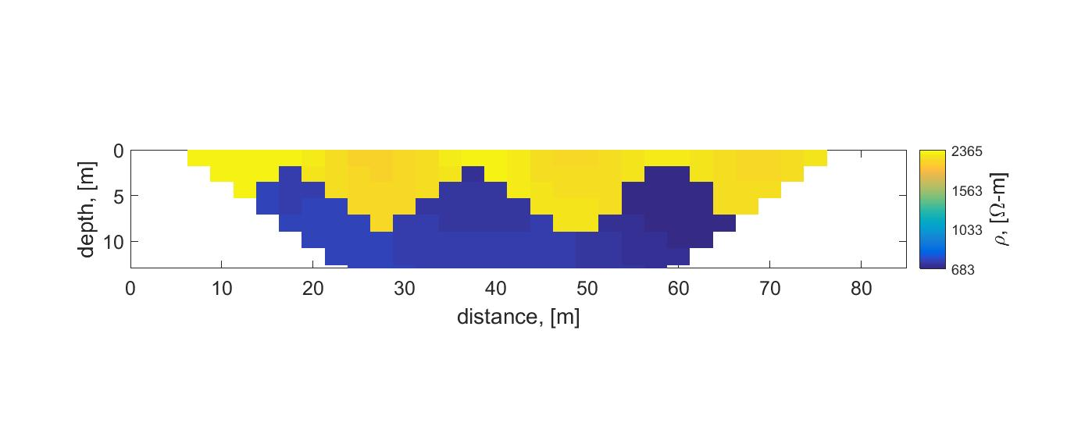
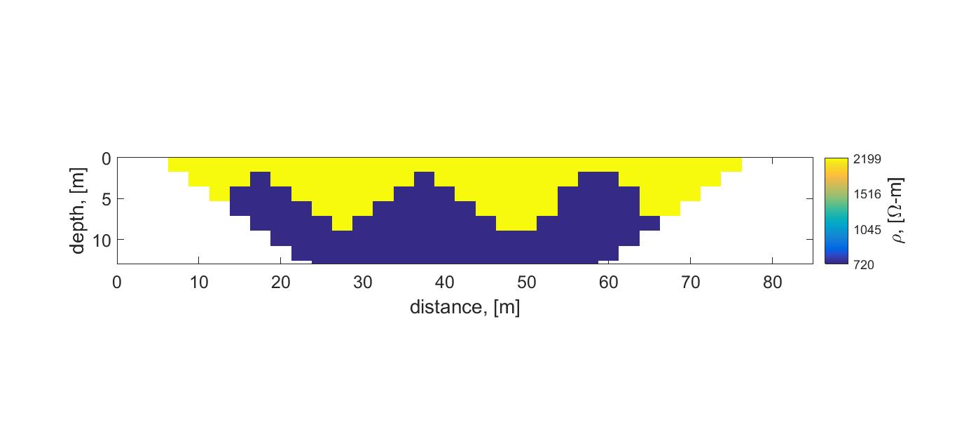



Data Residual con’t
log$(φ$_{d})
Choose R with smallest $φ$_{d} as$α→∞$
log$(α$)

Slide 13

Identify Best Boundary Estimate: Subregion variability
Incorrect R results in smearing near discontinuity
Identify parameter variability within each inverted subregion
Fit n_{s} Gaussians to histogram of inverted parameters
Determine $σ$for each Gaussian

Slide 14
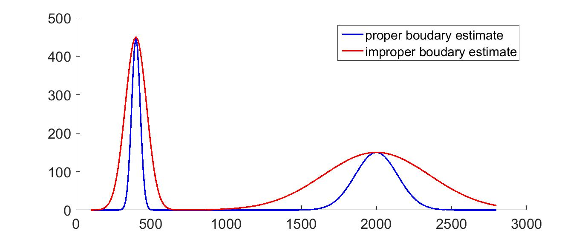

Subregion variability, n_{s}=2
Improper boundary estimate results in more variability in subregions.
R that gives inverted parameters with smallest $σ$ is best boundary estimate.

Slide 15
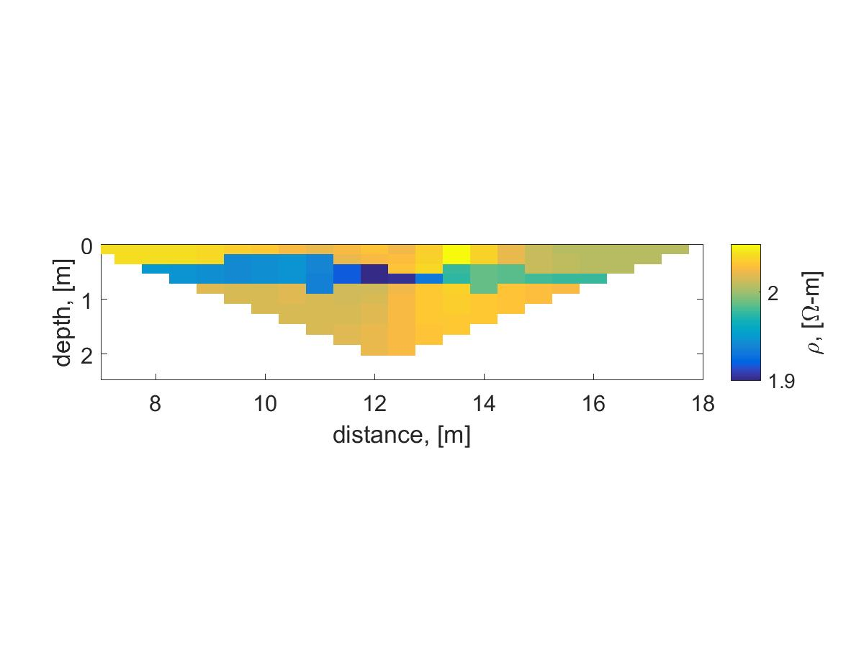
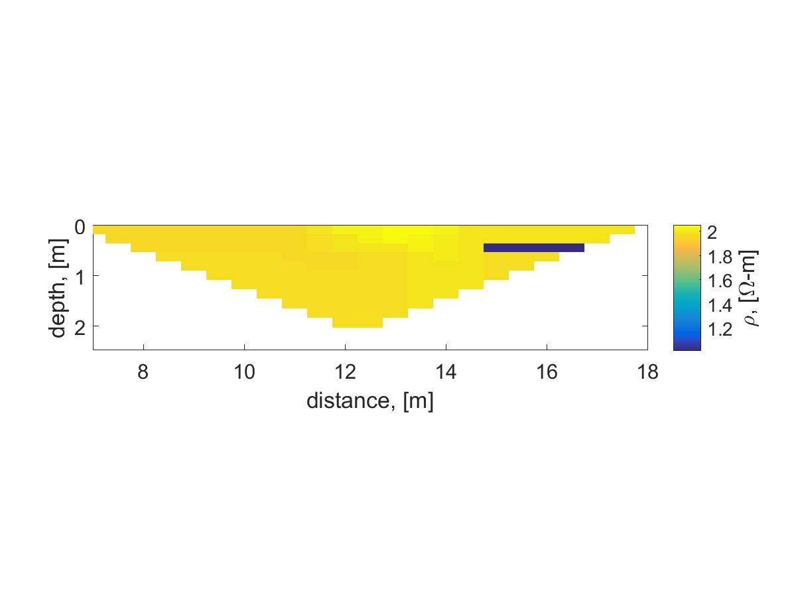
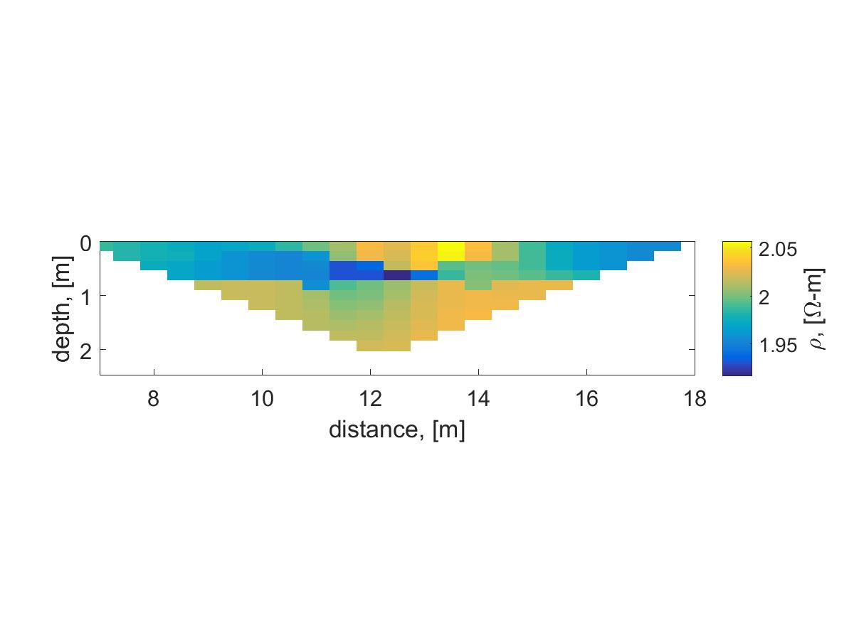
ERT Inversion results from BHRS
Proper R
R shifted up
R shifted down

Slide 16
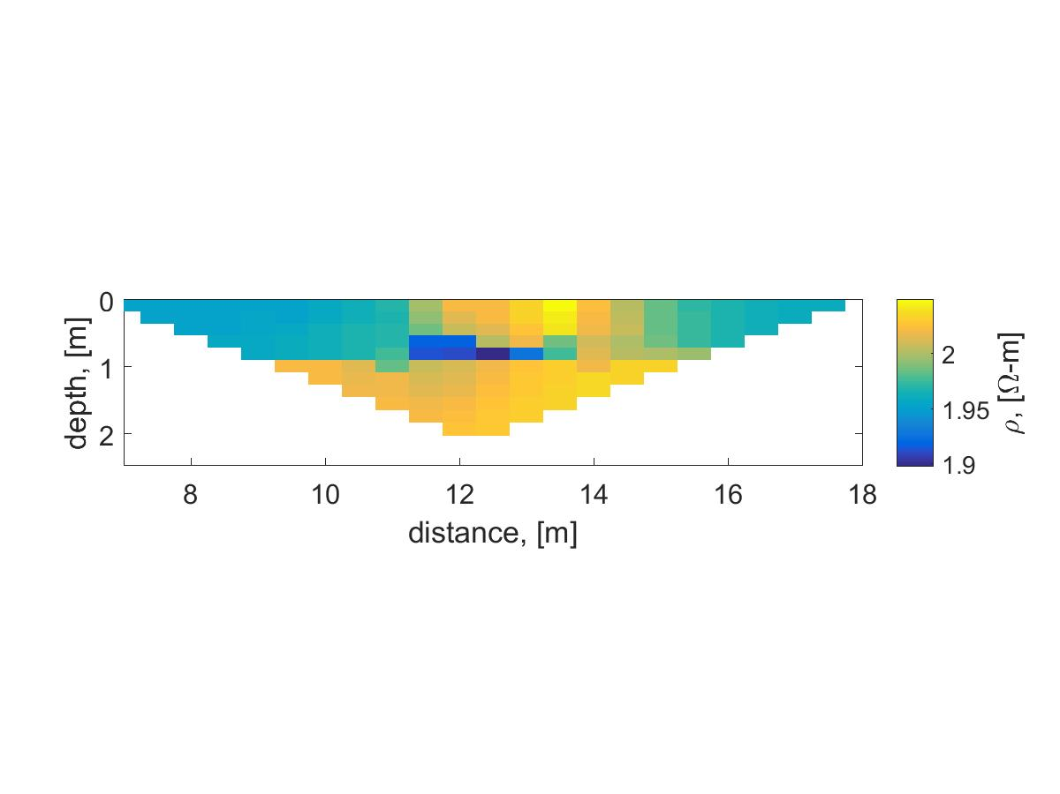
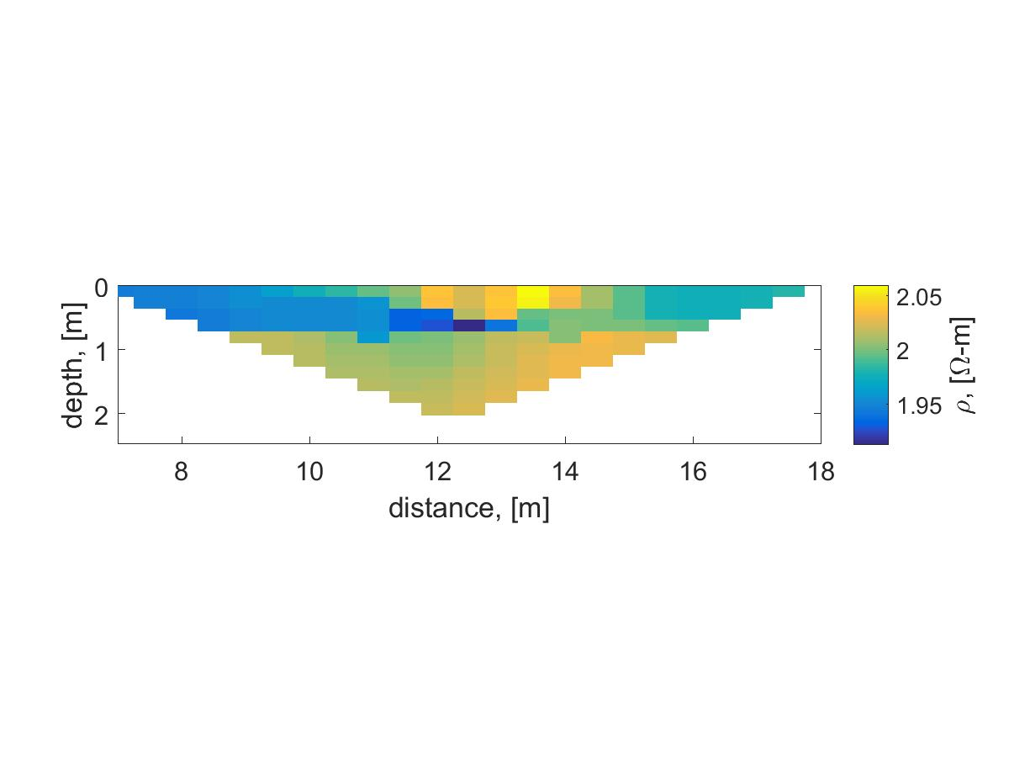
ERT Inversion results from BHRS
Proper R
R shifted left
R shifted right

Slide 17
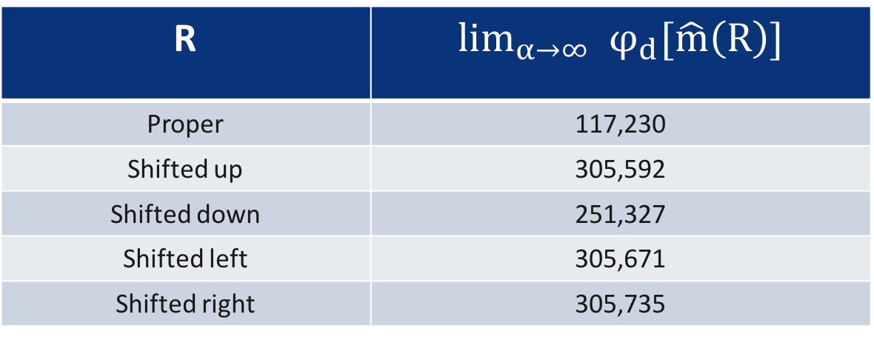
Data Residual for BHRS dataset
R | $${\lim_{α→∞} φ}_{d}[\hat{m}\left(R\right)]$$
Proper | 117,230
Shifted up | 305,592
Shifted down | 251,327
Shifted left | 305,671
Shifted right | 305,735

Slide 18
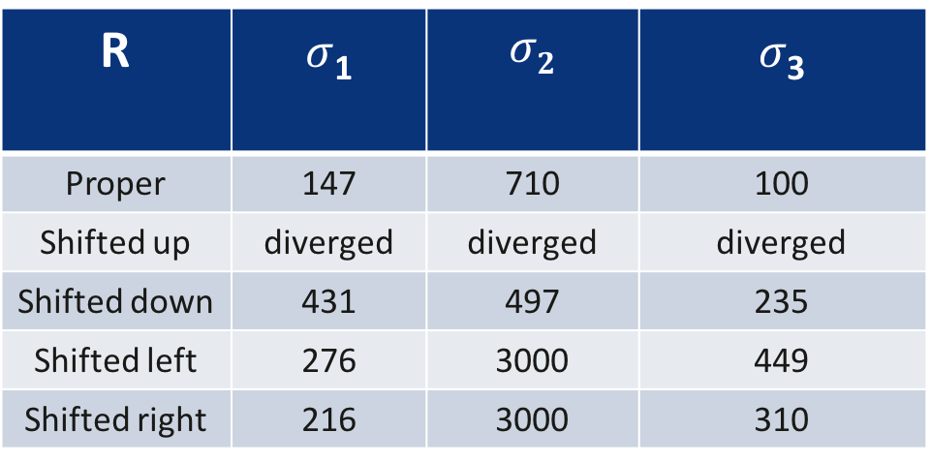
Subregion variability for BHRS dataset
R | $σ$₁ | $$σ2$$ | $σ$₃
Proper | 147 | 710 | 100
Shifted up | diverged | diverged | diverged
Shifted down | 431 | 497 | 235
Shifted left | 276 | 3000 | 449
Shifted right | 216 | 3000 | 310

Slide 19
Summary and Conclusions
Discontinuities (subsurface boundaries) were identified with GPR and input into an ERT inversion algorithm as constraints or prior information.
Reliability of prior boundary information was evaluated with data residuals and subregion variability.
In addition to BHRS data set, this approach was tested on 7 different simulated examples. Together with theoretical justifications, we determined that the following are effective:
Including boundary information through R in the constraint
Identifying best R through data residuals and subregion variability

Slide 20
Thank You
Jodi Mead
Email: jmead@boisestate.edu

